Slide 1
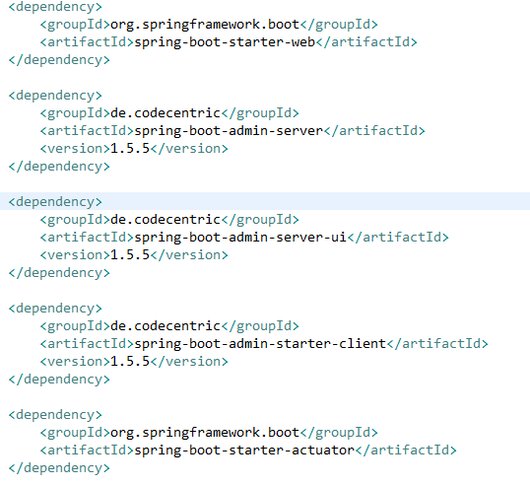
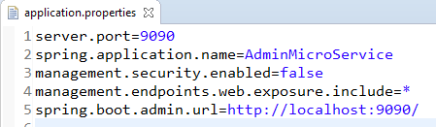
Spring Boot – Admin Server and Admin Client
Monitoring your application by using Spring Boot Actuator Endpoint is slightly difficult. Because, if you have ‘n’ number of applications, every application has separate actuator endpoints, thus making monitoring difficult. Spring Boot Admin Server is an application used to manage and monitor your Microservice application.
To handle such situations, CodeCentric Team provides a Spring Boot Admin UI to manage and monitor all your Spring Boot application Actuator endpoints at one place.
For monitoring and managing your micro service application via Spring Boot Admin Server, you should add the Spring Boot Admin starter client dependency and point out the Admin Server URI into the application properties file.
Note − For monitoring an application, you should enable the Spring Boot Actuator Endpoints for your Micro service application.

Slide 2
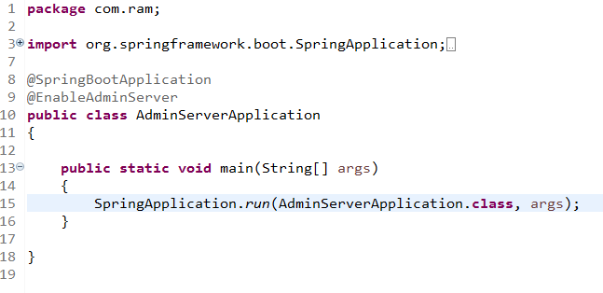
Spring Boot – Admin Server and Admin Client
Add the @EnableAdminServer annotation in your main Spring Boot application class file. The @EnableAdminServer annotation is used to make your as Admin Server to monitor all other microservices.

Slide 3
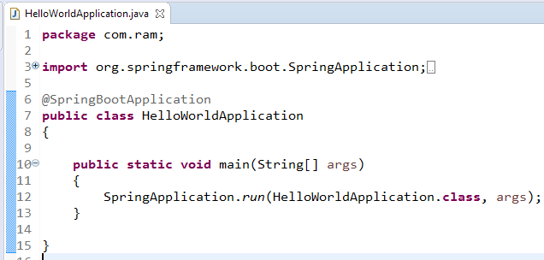
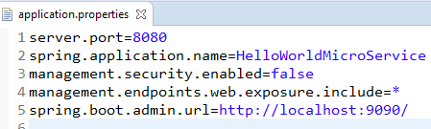
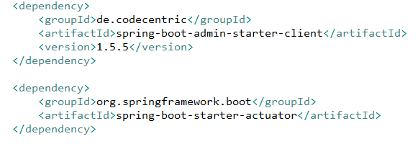
Spring Boot – Admin Server and Admin Client

Slide 4
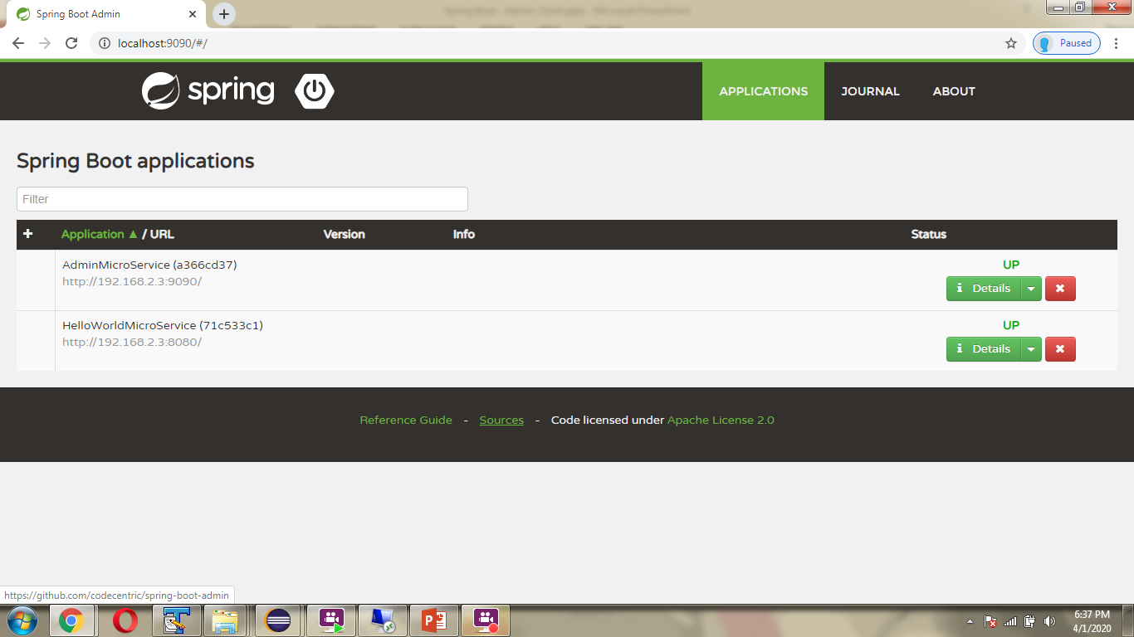
Spring Boot – Admin Server and Admin Client

